Slide 1
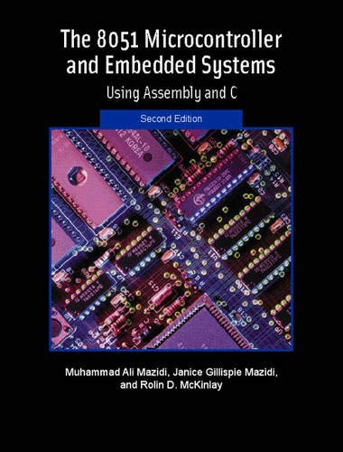
THE 8051
MICROCONTROLLER & Embedded Systems
Muhammad Ali Mazidi, Janice Mazidi
& Rolin McKinlay

Slide 2
LCD AND
KEYBOARD
INTERFACING
Chapter 12

Slide 3
Objectives
Upon completion of this chapter, you will be able to:
>> List reasons that LCDs are gaining widespread use, replacing LEDs
>> Describe the functions of the pins of a typical LCD
>> List instruction command codes for programming an LCD
>> Interface an LCD to the 8051
>> Program an LCD in Assembly and C
>> Explain the basic operation of a keyboard
>> Describe the key press and detection mechanisms
>> Interface a 4x4 keypad to the 8051 using C and Assembly

Slide 4
Objectives
Some real-world applications of the 8051Section and how to interface the 8051 to devices such as an LCD and a keyboard,
Section 12.1, LCD interfacing with the 8051,
Section 12.2, keyboard interfacing with the 8051,
C and Assembly for both sections

Slide 5
Table 12-1: Pin Descriptions for LCD
Pin Symbol I/O Description
1 VSS -- Ground
2 VCC -- +5V power supply
3 VEE -- Power supply to control contrast
4 RS I RS = 0 to select command register, RS = 1 to select data register
5 R/W I R/W = 0 for write, R/W = 1 for read
6 E I/O Enable
7 DB0 I/O The 8-bit data bus
8 DB1 I/O The 8-bit data bus
9 DB2 I/O The 8-bit data bus
10 DB3 I/O The 8-bit data bus
11 DB4 I/O The 8-bit data bus
12 DB5 I/O The 8-bit data bus
13 DB6 I/O The 8-bit data bus
14 DB7 I/O The 8-bit data bus

Slide 6
Table 12-2: LCD Command Codes
Code (Hex) Command to LCD Instruction Register
1 Clear display screen
2 Return home
4 Decrement cursor (shift cursor to left)
6 Increment cursor (shift cursor to right)
5 Shift display right
7 Shift display left
8 Display off, cursor off
A Display off, cursor on
C Display on, cursor off
E Display on, cursor blinking
F Display on, cursor blinking
10 Shift cursor position to left
14 Shift cursor position to right
18 Shift the entire display to the left
1C Shift the entire display to the right
80 Force cursor to beginning of 1st line
C0 Force cursor to beginning of 2nd line
38 2 lines and 5x7 matrix
Note: This table is extracted
from Table 12-4.

Slide 7
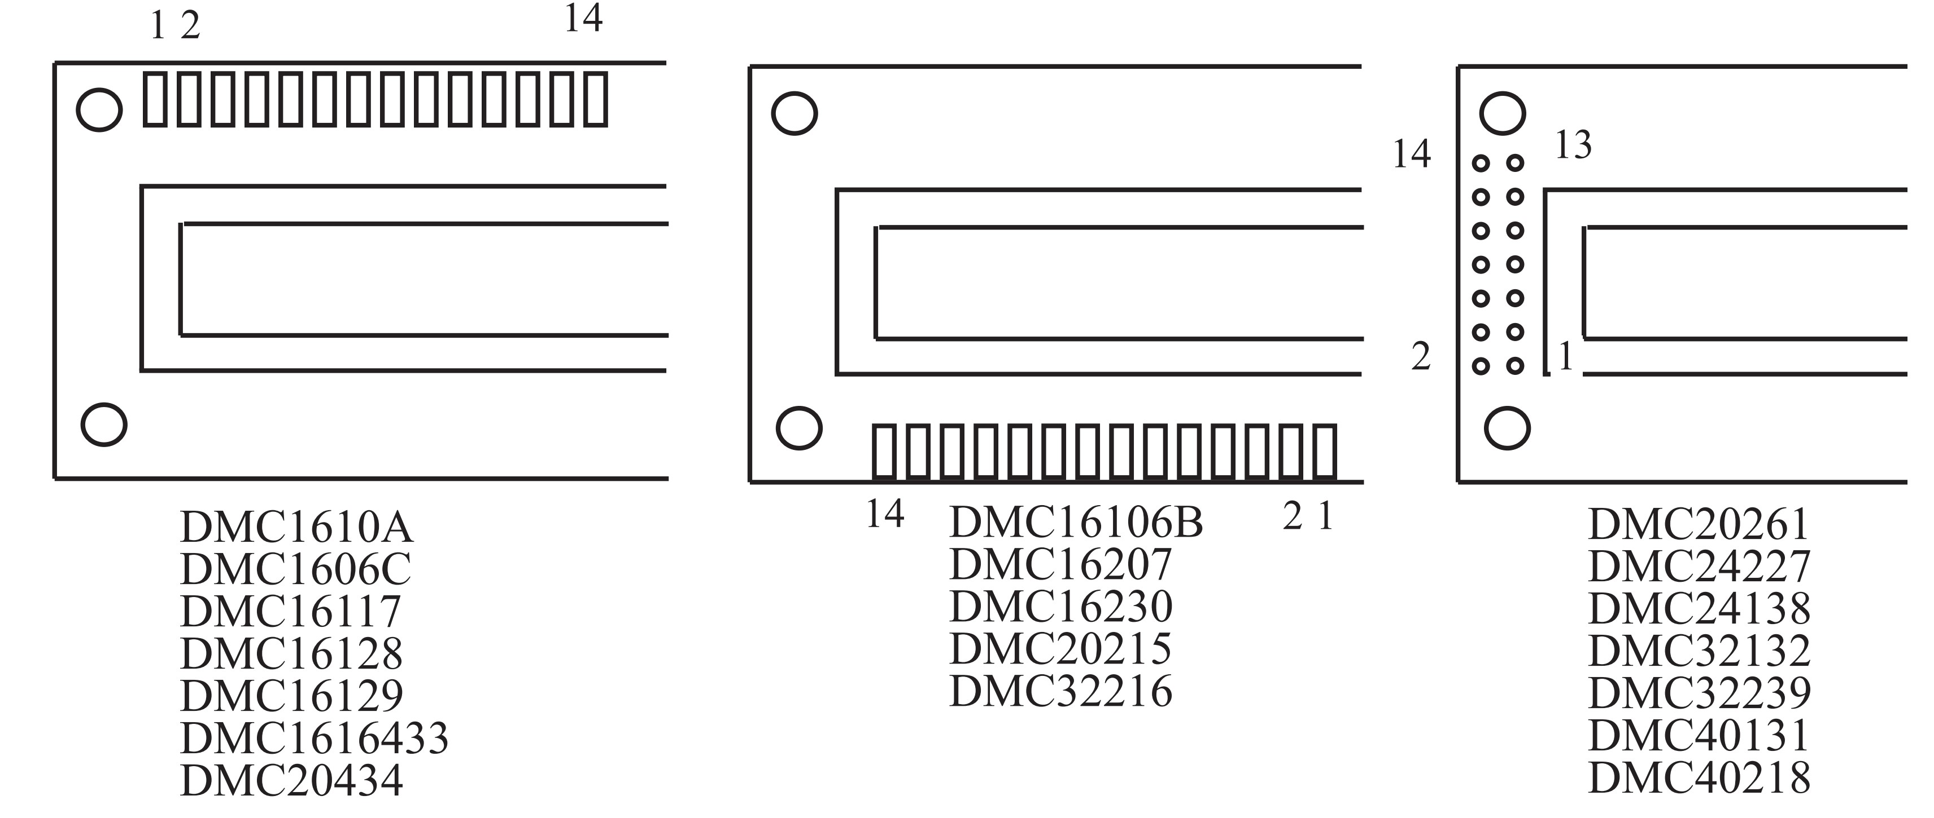
Figure 12-1. Pin Positions for Various LCDs from Optrex

Slide 8
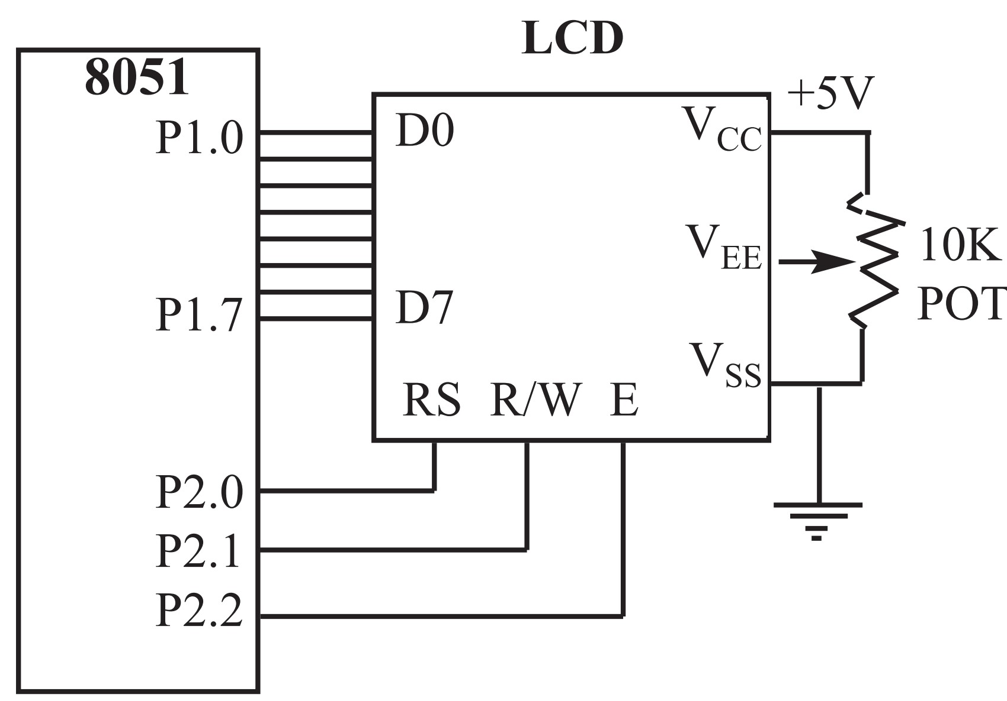
Figure 12-2. LCD Connections

Slide 9
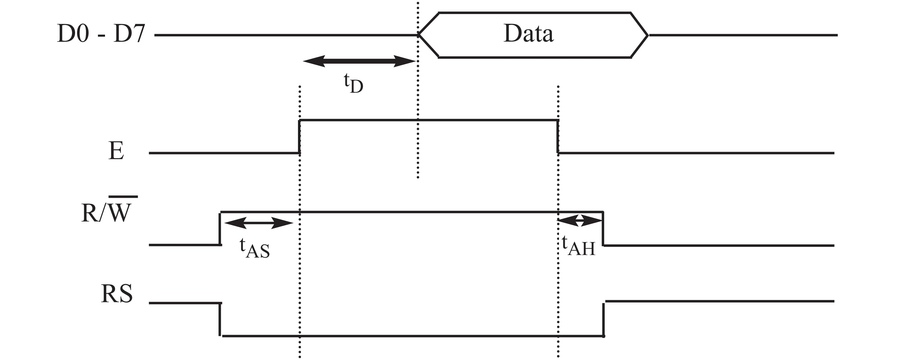
Figure 12-3. LCD Timing for Read ( L-to-H for E line)
tD = Data output delay time
tAS = Setup time prior to E (going high) for both RS and R/W = 140 ns (minimum)
tAH = Hold time after E has come down for both RS and R/W = 10 ns (minimum)
Note: Read requires an L-to-H pulse for the E pin.

Slide 10
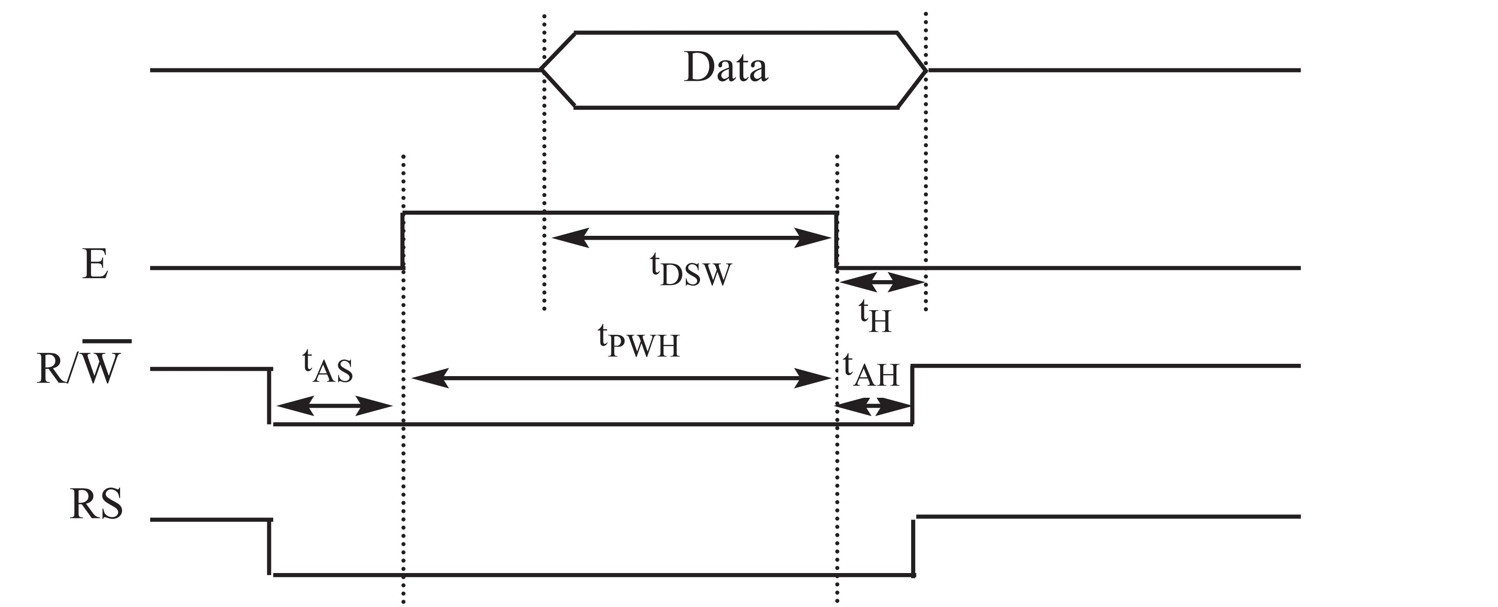
Figure 12-4. LCD Timing for Write (H-to-L for E line)
tPWH = Enable pulse width = 450 ns (minimum)
tDSW = Data setup time = 195 ns (minimum)
tH = Data hold time = 10 ns (minimum)
tAS = Setup time prior to E (going high) for both RS and R/W = 140 ns (minimum)
tAH = Hold time after E has come down for both RS and R/W = 10 ns (minimum)

Slide 11
LCD Data Sheet
RS R/W DB7 DB6 DB5 DB4 DB3 DB2 DB1 DB0
0 0 1 A A A A A A A
where AAAAAAA = 0000000 to 0100111 for line 1
and AAAAAAA = 1000000 to 1100111 for line 2.

Slide 12
Table 12-3: LCD Addressing
DB7 DB6 DB5 DB4 DB3 DB2 DB1 DB0
Line 1 (min) 1 0 0 0 0 0 0 0
Line 1 (max) 1 0 1 0 0 1 1 1
Line 2 (min) 1 1 0 0 0 0 0 0
Line 2 (max) 1 1 1 0 0 1 1 1

Slide 13
Figure 12-5. Cursor Addresses for Some LCDs
16 x 2 LCD 80 81 82 83 84 85 86 through 8F
C0 C1 C2 C3 C4 C5 C6 through CF
20 x 1 LCD 80 81 82 83 through 93
20 x 2 LCD 80 81 82 83 through 93
C0 C1 C2 C3 through D3
20 x 4 LCD 80 81 82 83 through 93
C0 C1 C2 C3 through D3
94 95 96 97 through A7
D4 D5 D6 D7 through E7
40 x 2 LCD 80 81 82 83 through A7
C0 C1 C2 C3 through E7
Note: All data is in hex.

Slide 14
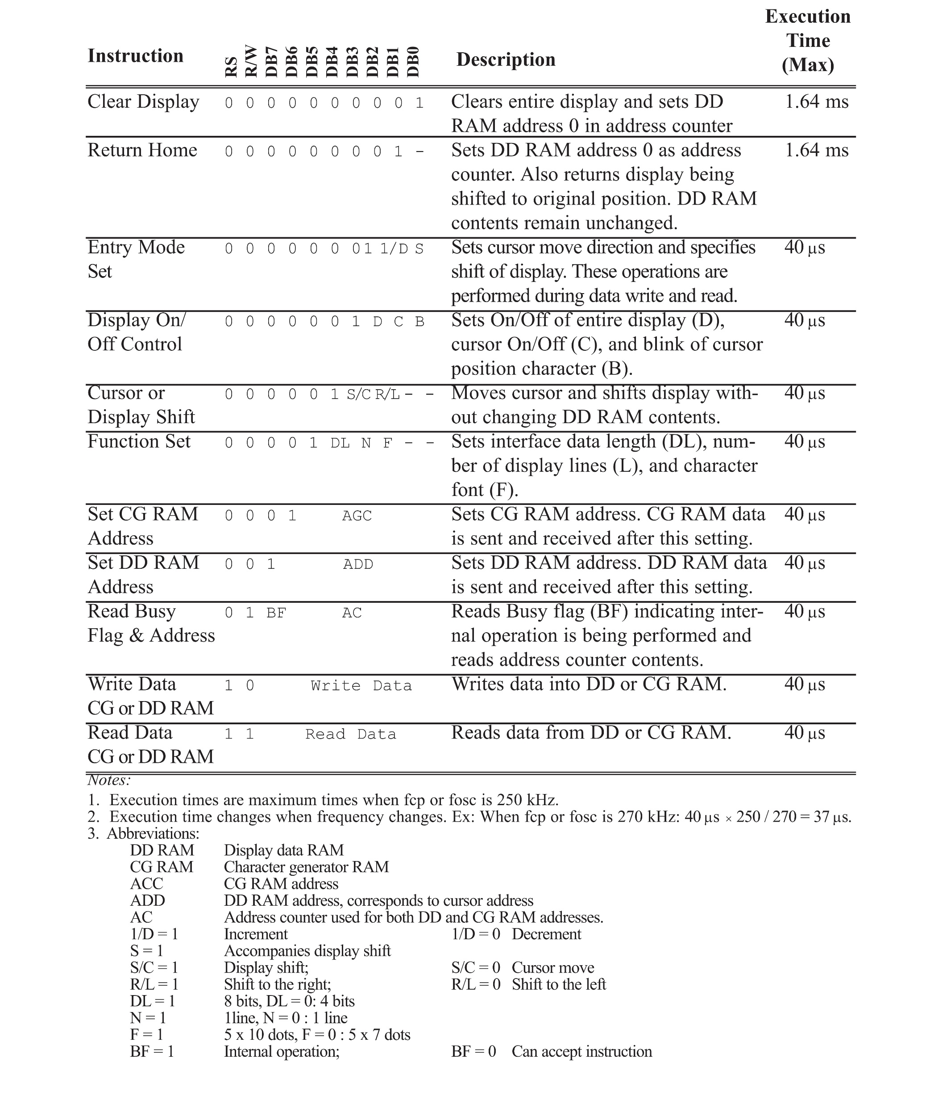
Table 12-4: List of LCD Instructions

Slide 15
Table 12-4: List of LCD Instructions

Slide 16
Table 12-4: List of LCD Instructions
Notes:
1. Execution times are maximum times when fcp or fosc is 250 kHz.
2. Execution time changes when frequency changes. Ex: When fcp or fosc is 270 kHz: 40 µs x 250 / 270 = 37 µs.
3. Abbreviations:
DD RAM Display data RAM
CG RAM Character generator RAM
ACC CG RAM address
ADD DD RAM address, corresponds to cursor address
AC Address counter used for both DD and CG RAM addresses.
1/D = 1 Increment 1/D = 0 Decrement
S = 1 Accompanies display shift
S/C = 1 Display shift; S/C = 0 Cursor move
R/L = 1 Shift to the right; R/L = 0 Shift to the left
DL = 1 8 bits, DL = 0: 4 bits
N = 1 1line, N = 0 : 1 line
F = 1 5 x 10 dots, F = 0 : 5 x 7 dots
BF = 1 Internal operation; BF = 0 Can accept instruction

Slide 17
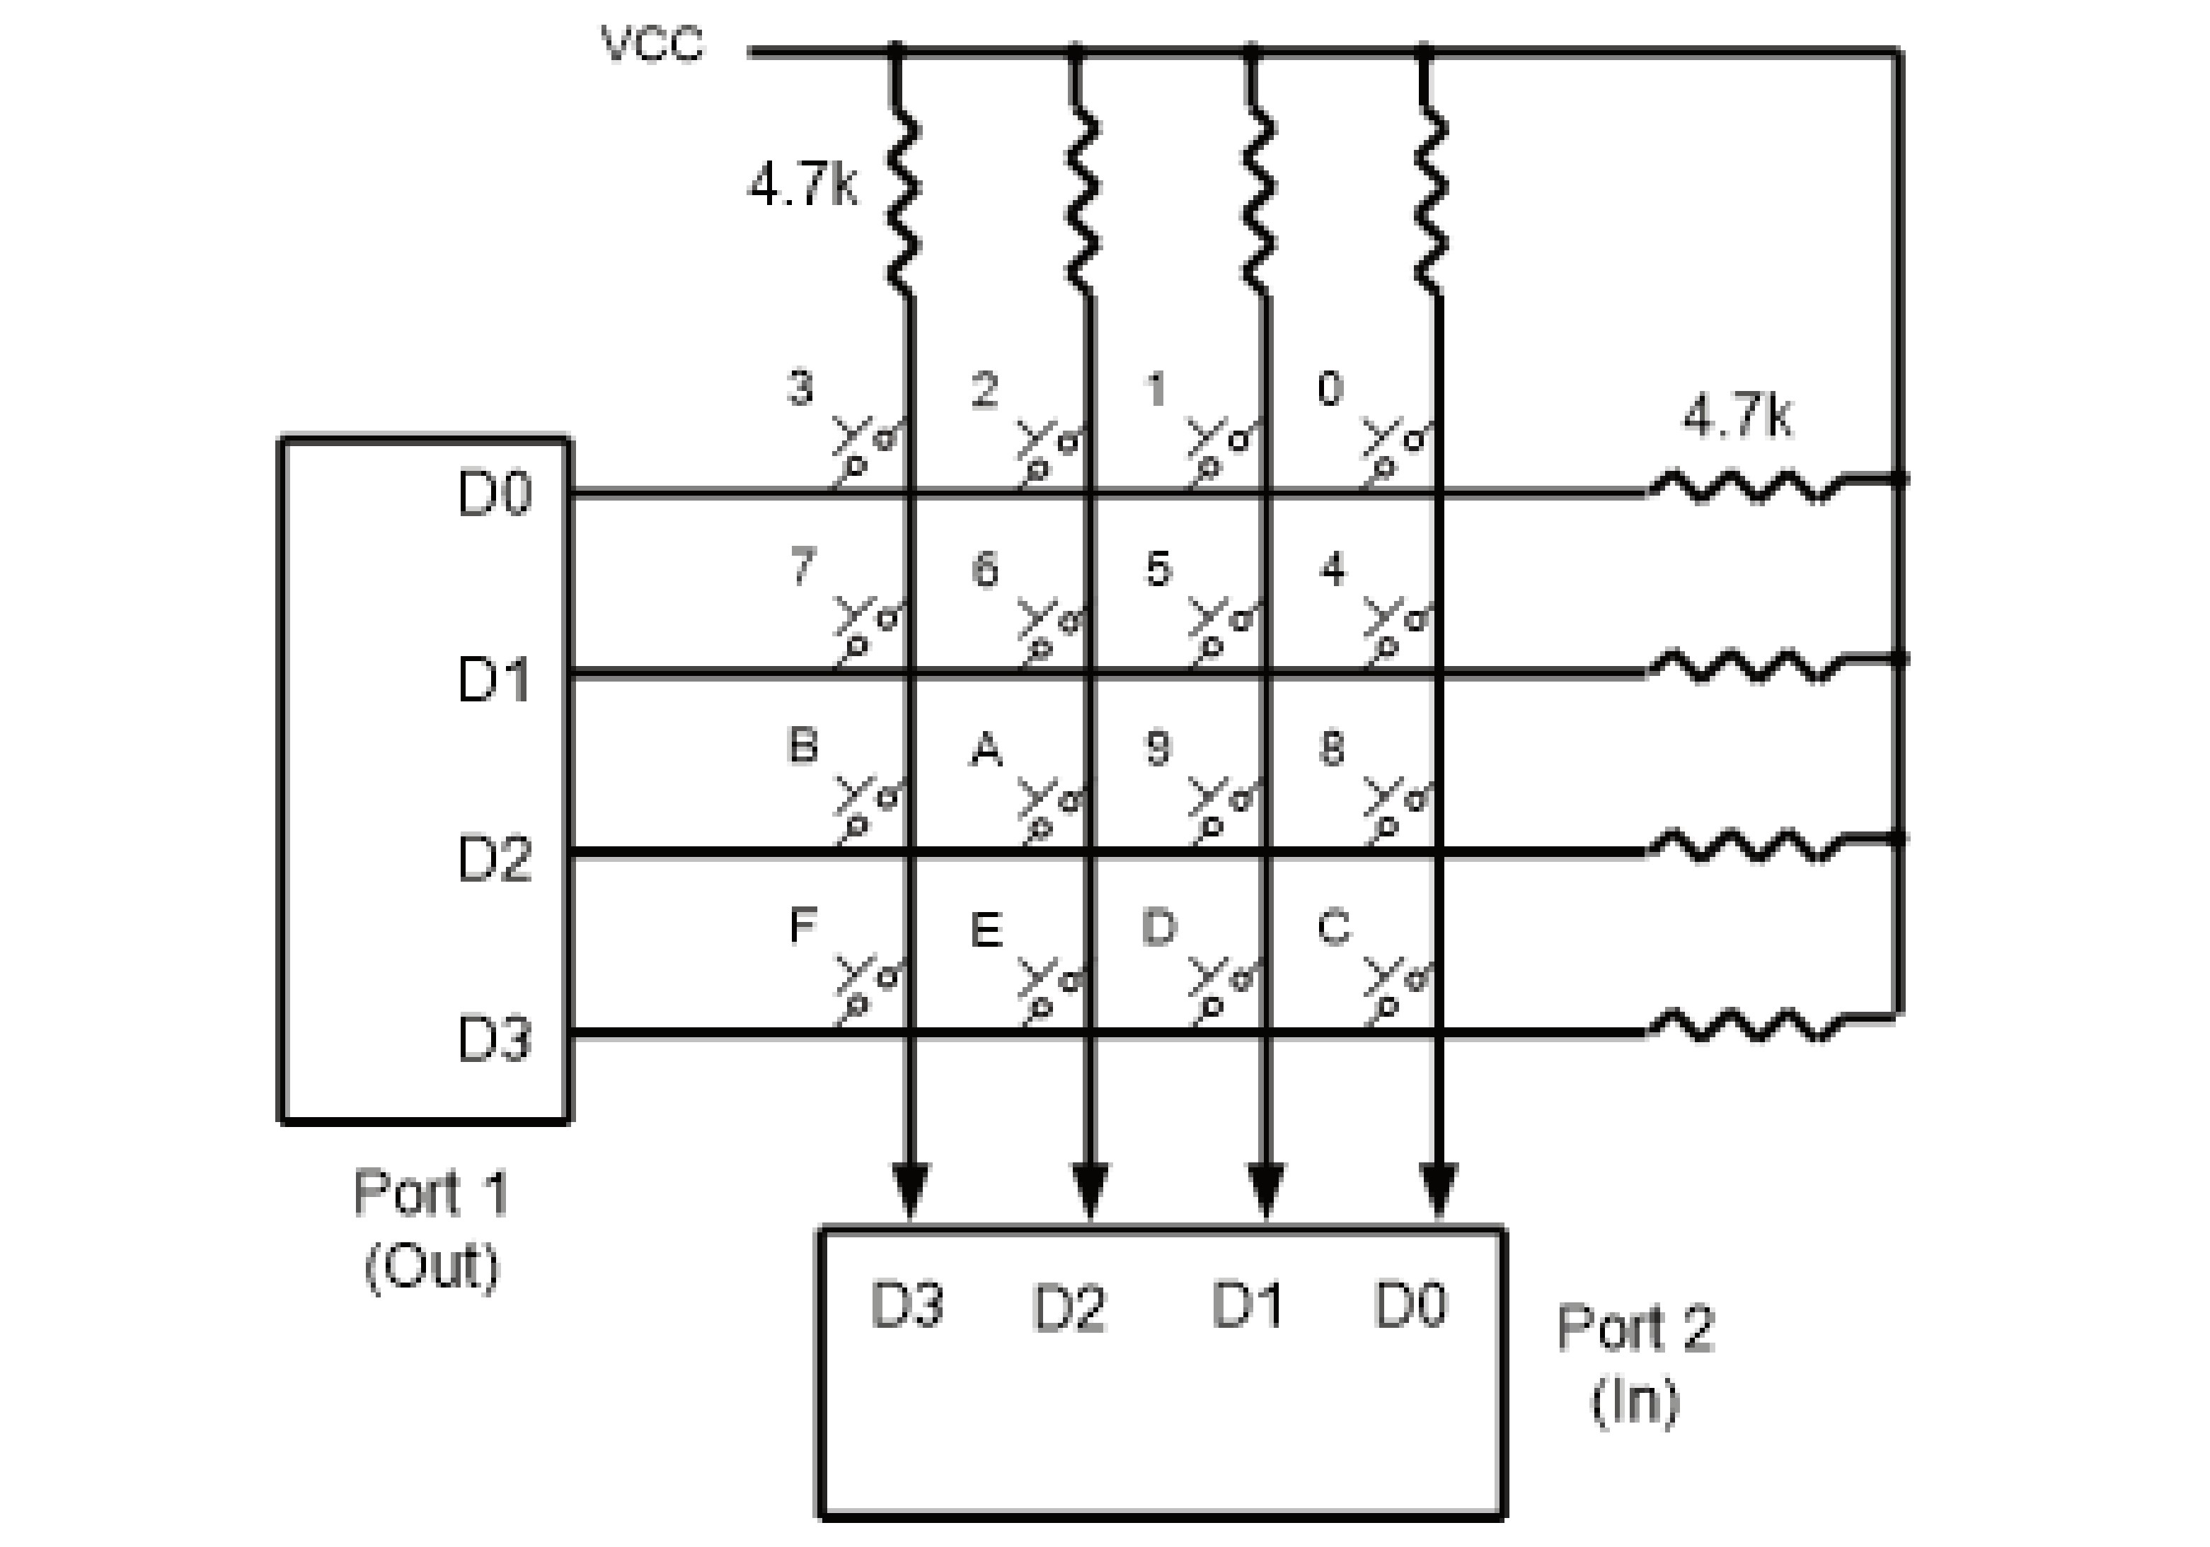
Figure 12-6. Matrix Keyboard Connection to Ports

Slide 18
Write an 8051 C program to send letters ‘M’, ‘D’,
and ‘E’ to the LCD using delays.
Example 12-1
Solution:
#include <reg51.h>
sfr ldata = 0x90; //P1=LCD data pins (Fig. 12-2)
sbit rs = P2^0;
sbit rw = P2^1;
sbit en = P2^2;
void main()
{
lcdcmd(0x38);
MSDelay(250);
lcdcmd(0x0E);
MSDelay(250);
lcdcmd(0x01);
MSDelay(250);
lcdcmd(0x06);
MSDelay(250);
lcdcmd(0x86); //line 1, position 6
MSDelay(250);
lcddata('M');
MSDelay(250);
lcddata('D');
MSDelay(250);
lcddata('E');
}
void lcdcmd(unsigned char value)
{
ldata = value; // put the value on the pins
rs = 0;
rw = 0;
en = 1; // strobe the enable pin
MSDelay(1);
en = 0;
return;
}
void lcddata(unsigned char value)
{
ldata = value; // put the value on the pins
rs = 1;
rw = 0;
en = 1; // strobe the enable pin
MSDelay(1);
en = 0;
return;
}
void MSDelay(unsigned int itime)
{
unsigned int i, j;
for(i=0;i<itime;i++)
for(j=0;j<1275;j++);
}

Slide 19
Repeat Example 12-1 using the busy flag method.
Example 12-2
Solution:
#include <reg51.h>
sfr ldata = 0x90; //P1=LCD data pins (Fig. 12-2)
sbit rs = P2^0;
sbit rw = P2^1;
sbit en = P2^2;
sbit busy = P1^7;
void main()
{
lcdcmd(0x38);
lcdcmd(0x0E);
lcdcmd(0x01);
lcdcmd(0x06);
lcdcmd(0x86); //line 1, position 6
lcddata('M');
lcddata('D');
lcddata('E');
}
void lcdcmd(unsigned char value)
{
lcdready(); //check the LCD busy flag
ldata = value; //put the value on the pins
rs = 0;
rw = 0;
en = 1; //strobe the enable pin
MSDelay(1);
en = 0;
return;
}
void lcddata(unsigned char value)
{
lcdready(); //check the LCD busy flag
ldata = value; //put the value on the pins
rs = 1;
rw = 0;
en = 1; //strobe the enable pin
MSDelay(1);
en = 0;
return;
}
void lcdready()
{
busy = 1; //make the busy pin an input
rs = 0;
rw = 1;
while(busy==1) //wait here for busy flag
{
en = 0; //strobe the enable pin
MSDelay(1);
en = 1;
}
return;
}
void MSDelay(unsigned int itime)
{
unsigned int i, j;
for(i=0;i<itime;i++)
for(j=0;j<1275;j++);
}

Slide 20
Example 12-3
From Figure 12-6, identify the row and column of the pressed key for each of the following.
(a) D3 - D0 = 1110 for the row, D3 - D0 = 1011 for the column
(b) D3 - D0 = 1101 for the row, D3 - D0 = 0111 for the column
Solution:
From Figure 12-6 the row and column can be used to identify the key.
(a)The row belongs to D0 and the column belongs to D2; therefore, key number 2 was pressed.
(b)The row belongs to D1 and the column belongs to D3; therefore, key number 7 was pressed.

Slide 21
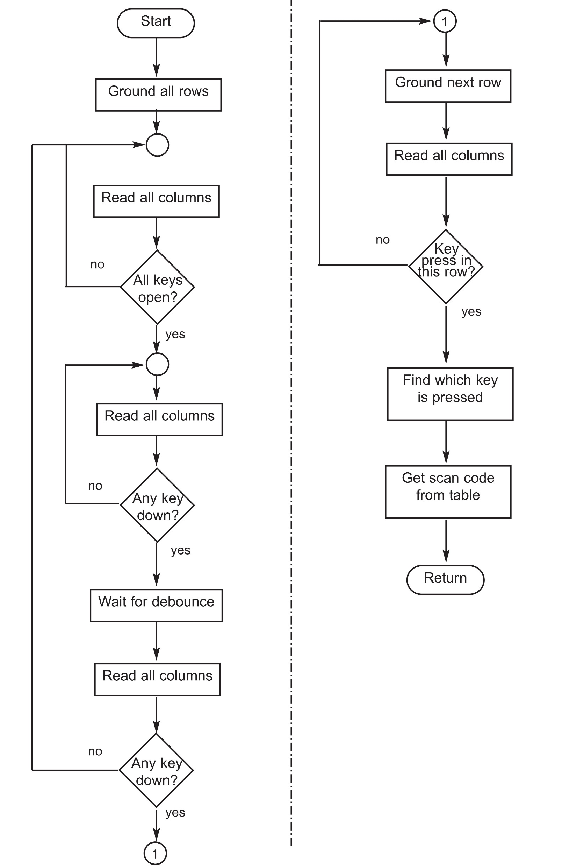
Figure 12-7. Flowchart for Program 12-4

Slide 22
Write a C program to read the keypad and send the result to the first serial port. P1.0-P1.3 connected to rows
P2.0-P1.3 connected to columns Configure the serial port for 9600 baud, 8-bit, and 1 stop bit.
Example 12-4
Solution:
#include <reg51.h>
#define COL P2 //define ports for easier reading
#define ROW P1
void MSDelay(unsigned int value);
void SerTX(unsigned char);
unsigned char keypad[4][4] = {'0','1','2','3','4','5','6','7','8',’9’
,'A','B','C','D','E','F'};
void main()
{
unsigned char colloc, rowloc;
TMOD = 0x20; //timer 1, mode 2
TH1 = -3; //9600 baud
SCON = 0x50; //8-bit, 1 stop bit
TR1 = 1; //start timer 1
//keyboard routine. This sends the ASCII
//code for pressed key to the serial port
COL = 0xFF; //make P2 an input port
while(1) //repeat forever
{
do
{
ROW = 0x00; //ground all rows at once
colloc = COL; //read the columns
colloc &= 0x0F; //mask used bits
} while(colloc != 0x0F); //check until all keys released
do
{
do
{
MSDelay(20); //call delay
colloc = COL; //see if any key is pressed
colloc &= 0x0F; //mask unused bits
} while(colloc == 0x0F);//keep checking for keypress
MSDelay(20); //call delay for debounce
colloc = COL; //read columns
colloc &= 0x0F; //mask unused bits
} while(colloc == 0x0F);//wait for keypress
while(1)
{
ROW = 0xFE; //ground row 0
colloc = COL; //read columns
colloc &= 0x0F; //mask unused bits
if(colloc != 0x0F) //column detected
{
rowloc = 0; //save row location
break; //exit while loop
}
ROW = 0xFD; //ground row 1
colloc = COL; //read columns
colloc &= 0x0F; //mask unused bits
if(colloc != 0x0F) //column detected

Slide 23
Write a C program to read the keypad and send the result to the first serial port. P1.0-P1.3 connected to rows
P2.0-P1.3 connected to columns Configure the serial port for 9600 baud, 8-bit, and 1 stop bit. Cont.
Example 12-4
Solution:
{
rowloc = 1; //save row location
break; //exit while loop
}
ROW = 0xFB; //ground row 2
colloc = COL; //read columns
colloc &= 0x0F; //mask unused bits
if(colloc != 0x0F) //column detected
{
rowloc = 2; //save row location
break; //exit while loop
}
ROW = 0xF7; //ground row 3
colloc = COL; //read columns
colloc &= 0x0F; //mask unused bits
rowloc = 3; //save row location
break; //exit while loop
}
//check column and send result to the serial port
if(colloc == 0x0E)
SerTX(keypad[rowloc][0]);
else if(colloc == 0x0D)
SerTX(keypad[rowloc][1]);
else if(colloc == 0x0B)
SerTX(keypad[rowloc][2]);
else
SerTX(keypad[rowloc][3]);
}
}
void SerTX(unsigned char x)
{
SBUF = x; //place value in buffer
while(TI==0); //wait until transmitted
TI = 0; //clear flag
}
void MSDelay(unsigned int value)
{
unsigned int x, y;
for(x=0;x<1275;x++)
for(y=0;y<value;y++);
}

